Slide 1
Chapter 2: Chemical Equilibrium
Reversible reactions and dynamic equilibrium

Slide 2
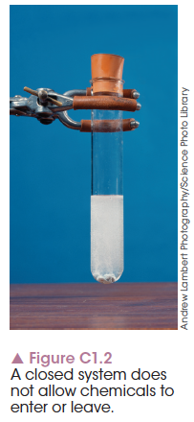
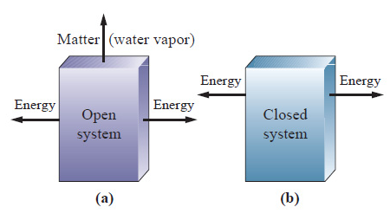
Chemical systems- Open and Closed System
The chemicals involved in a reaction form the chemical system. Anything around it forms the surroundings.
If the chemicals are contained within a space and cannot enter or leave, the system is a closed system.
If substances can be added or lost, the system is an open system.
Notes:
Explain a chemical system using an example such as:
The reaction between oxygen and hydrogen gas to form water vapour – the oxygen/hydrogen/water make up the chemical system, while other air molecules are the surroundings.
In an aqueous environment, the water is part of the system if involved in the reaction, and is part of the surroundings if not involved in the reaction.
Examples of closed systems include:
All aqueous solution/liquid systems – e.g. hydrochloric acid and sodium hydroxide and the products
May include gases if the container is closed – e.g. hydrochloric acid and calcium carbonate with carbon dioxide as a product is a closed system if the container is closed and the carbon dioxide cannot escape. It is an open system if the carbon dioxide can escape from an open container.
May include solids – e.g. addition of an acid to a solid piece of metal

Slide 3
Physical and chemical change
Chemical systems may be open or closed and include physical and chemical changes, which result in observable changes.
Physical change – products change state and physical properties alter. (Example: boiling water to form steam.)
Chemical change – reactants form products with different physical and chemical properties.
Notes:
Simple examples of physical changes include melting and boiling of water.
Simple examples of chemical changes include acid–base or acid–metal reactions.

Slide 4
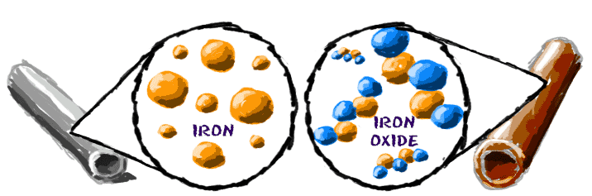
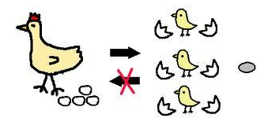
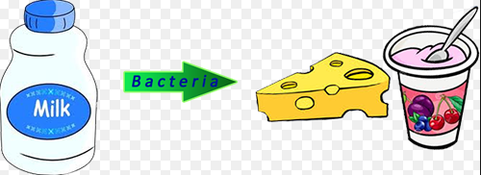
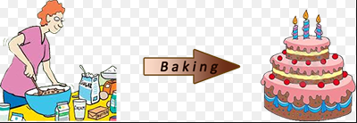
Irreversible and Reversible Systems
Products can not be converted into reactants- irreversible reactions.
Non- reversible reactions have very high activation energy for both forward and reverse reactions.

Slide 5
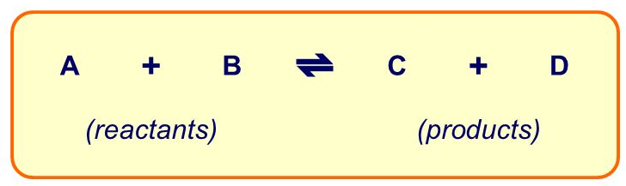
Reversible Changes
Products can be converted into reactants.
Most physical changes are reversible
Some chemical changes are reversible.
Reversible reactions have a low Ea for both Fw and Rv reactions.
Reversible reactions do not go completion, once the products are formed they combine to form the reactants.

Slide 6
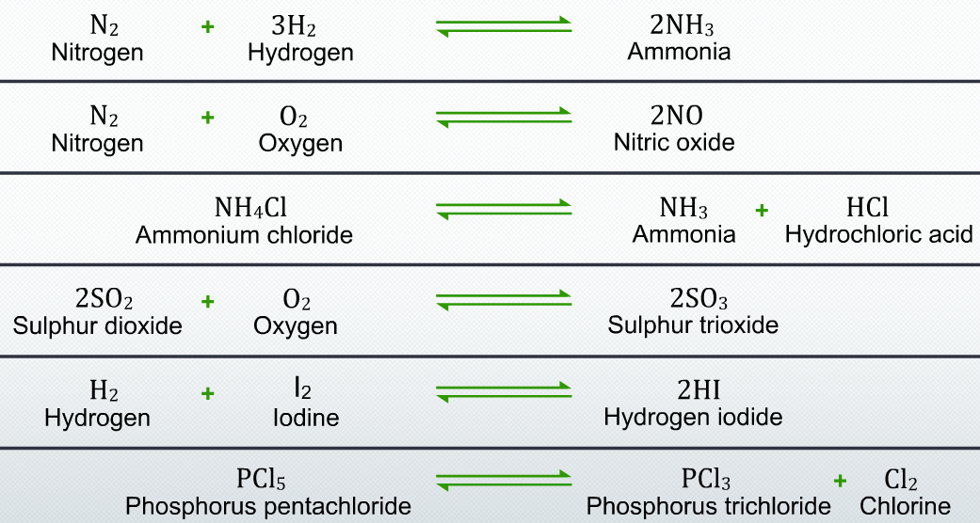
Reversible reactions Examples

Slide 7
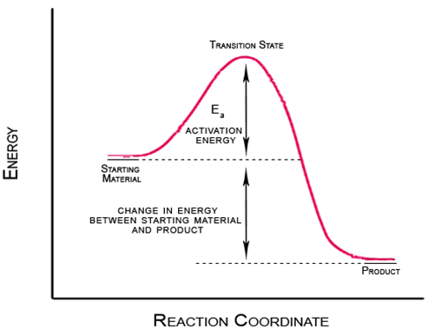
Predicting Reversibility
Why some rxn are reversible?
Ea- activation energy is the amount of energy to break the bond.
Size of Ea influence the reaction proceedings.

Slide 8
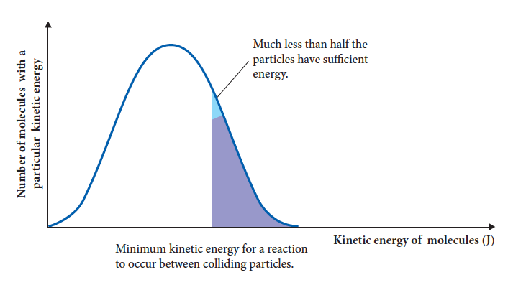

Predicting reversibility
Reversible reactions are likely to form when the activation energies of both forward and reverse reactions are low enough that sufficient particles have energy for a successful collision.

Slide 9
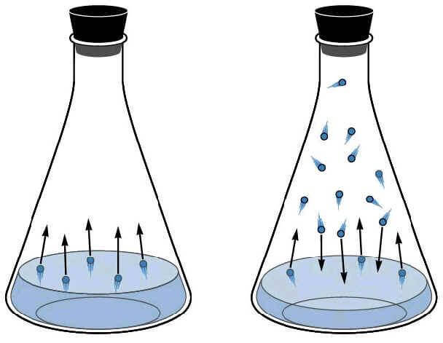
Reversibility of Physical Changes Evaporation and condensation of water
H₂O(l) → H₂O(g) Evaporation
H₂O(g) → H2O(l) Condensation
H₂O(l) ←→ H₂O(g)
Closed system
Rate of Fw reaction = Rate of Rv Reaction
No further change to the observer
State of equilibrium

Slide 10
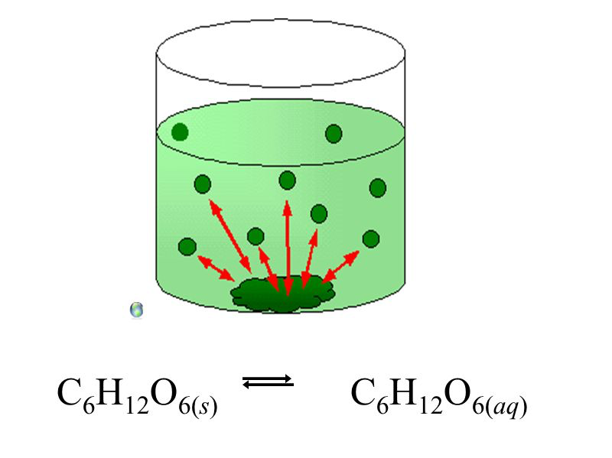
Saturated salt/sugar solution
Closed system
Sugar molecules dissolving at the same rate as they are crystallizing.
State of equilibrium

Slide 11
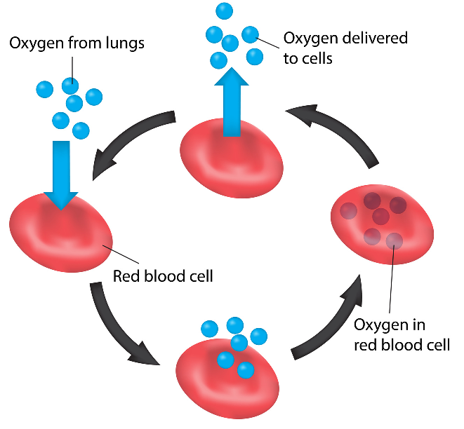

Haemoglobin and Oxygen Gas
Closed system
Reversible reaction
At equilibrium

Slide 12
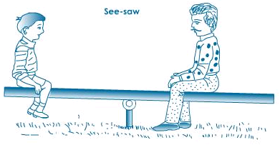
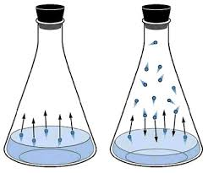
Dynamic Equilibrium
It is a state where the amount of reactants and products remains constant, however the Fw and Rv reactions still occur.
Also called a steady state system. These have constant observable properties such as pH, colour and volume.
2 types-
Physical equilibrium
Chemical equilibrium

Slide 13
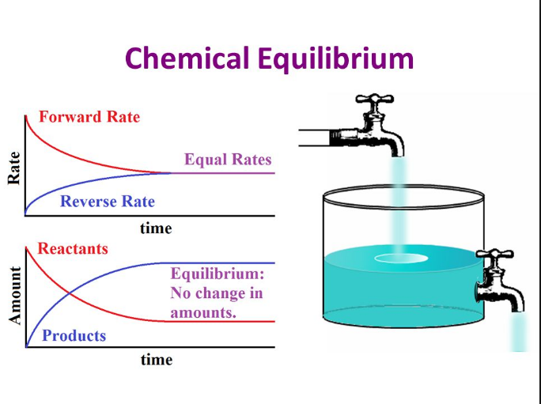
Understanding Equilibrium

Slide 14
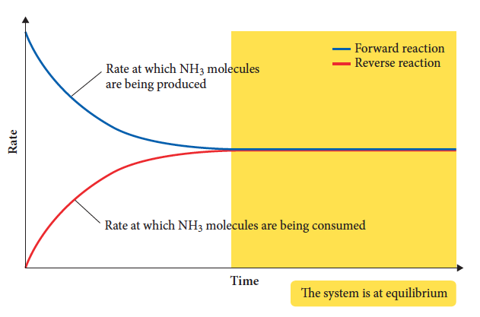
Equilibrium in chemical systems
Dynamic equilibrium happens when the rates of forward and reverse reactions are equal and concentrations of products and reactants are constant.
Notes:
Clearly explain the difference between a rate graph (Figure C1.9) and a concentration graph (Figure C1.8).
Concentration/time graphs do not have to have all reactants and products finishing at the same concentration. They often have more than two lines to represent all reactants and products.
Rate/time graphs only have two lines, which must finish at the same point. Rate/time graphs DO NOT show individual reactants and products; rather, they show the overall rates of consumption of reactants, or formation of products.

Slide 15
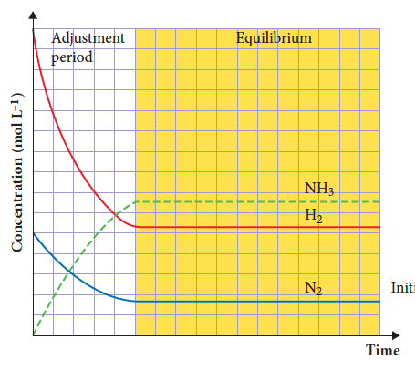
Equilibrium in chemical systems
Adding reactants to a system results in a fast initial rate of forward reaction that gradually slows as reactants form products.
Rate of forward reaction slows and rate of reverse reaction increases as concentrations change.
Notes:
Show how the graph (Figure C1.8) can be used to show changing rates by drawing tangents to the curves at various points. The steeper the line drawn, the faster the rate.
Show how the rate of reactants (hydrogen and nitrogen) slow down over time.
Show how the rate of products (ammonia) speed up over time.
Show why equilibrium is attained in the shaded yellow section (constant concentration, no further change in rate of reaction).

Slide 16
Equilibrium in chemical systems
Summary
A chemical system will reach equilibrium if it:
is a closed system
involves a reversible reaction.
At equilibrium, the:
rate of the forward reaction is the same as the rate of the reverse reaction
concentrations of the reactant and products remain constant
macroscopic properties are constant.

Slide 17
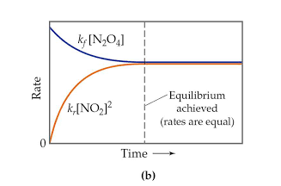
Graphing Equilibrium Rate and Time Graph
Time- X axis
Rate- Y axis
Initially Fw rate is very high, will decrease quickly then slowly.
Initially Rv rate zero will increase quickly then slowly
The rates will become equal when reached equilibrium

Slide 18
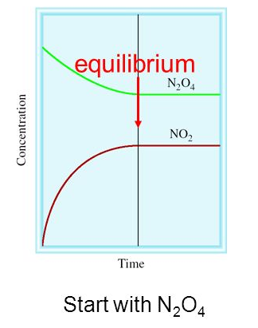

Concentration and Time Graph
Time- X axis
Conc- Y axis
Initially conc of reactants very high, will decrease quickly then slowly.
Initially conc of products zero, will increase quickly then slowly.
Plateau same when reaches equilibrium

Slide 19
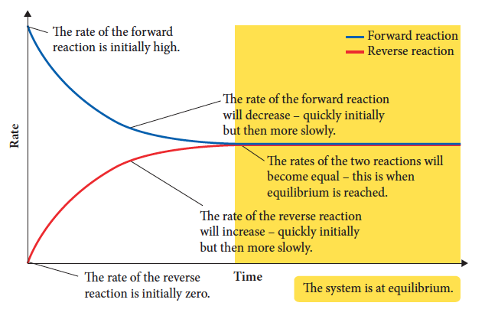
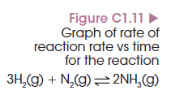
Graphing reaction rate and time
1 Rate of forward reaction is initially high.
2 Rate of reverse reaction is initially zero.
Notes:
Show how drawing a tangent to the curve represents a gradually decreasing slope and hence rate. Explain why, in terms of collision theory, decreasing numbers of molecules leads to decreasing frequency of collisions and a slower rate of reaction.
When the reactants (hydrogen and nitrogen) are initially added, there is no ammonia present so initial rate is zero. This is easily obtained off the graph.

Slide 20
Graphing reaction rate and time
3 Rate of the forward reaction will decrease.
4 Rate of the reverse reaction will increase.

Slide 21
Graphing reaction rate and time
5 Rates of the two reactions become equal and equilibrium is reached.
Notes:
Use tangents to the curve as on the previous slide to show how the slopes of the lines eventually become flat, showing no further change in rate of either forward or reverse reactions.

Slide 22
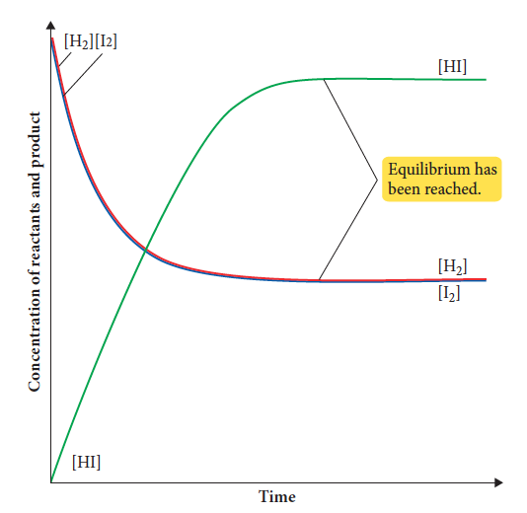

Graphing concentration and time
To discuss rate in these graphs, draw a tangent to the slope at a point.

Slide 23
Graphing concentration and time
1 Concentration of reactants is initially large.
2 Concentration of products is initially zero.

Slide 24
Graphing concentration and time
3 Concentration of reactants decreases, initially quickly, then more slowly.
4 Concentration of products increase, initially quickly, then more slowly.

Slide 25
Graphing Concentration and Time
5 All concentrations will plateau when the system reaches equilibrium.

Slide 26
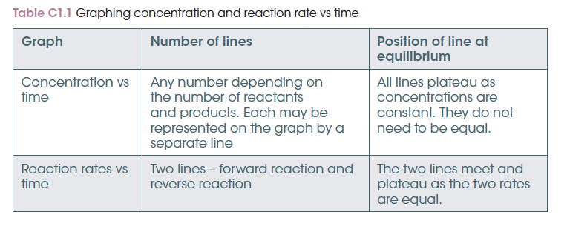
Graphing summary

Slide 27
Chapter 2: Equilibrium
Equilibrium constants

Slide 28
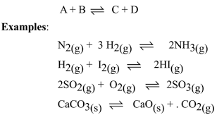
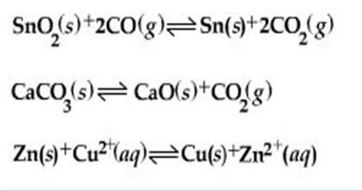
Homogeneous and Heterogeneous Equilibria
Homogeneous reaction- reactions and products are in same phase or state.
Heterogenous Reaction- reactions and products are in different phase or state.

Slide 29
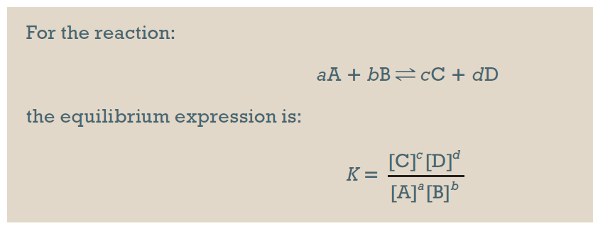
What is an equilibrium constant?
Equilibrium constant (also K) – the mathematical relationship between the concentrations of reactants and products. It is specific for a particular reaction at a particular temperature.
It can be calculated from the equilibrium expression.

Slide 30
What substances are included?
The equilibrium constant is based on the ratio of concentrations of reactants and products.
Solutions and gases vary in concentration so are included in the expression.
Solids and liquids do not vary in concentration.
They are NOT included when the system is heterogeneous (contains more than one phase).
They ARE included when the system is homogeneous (all solid or all liquid).

Slide 31
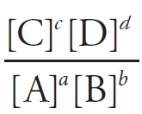
Reaction quotient
The equilibrium constant is equal to K when the system is at equilibrium.
If the system is not at equilibrium, the equilibrium expression can be used to calculate Q.
If Q = K then the system is at equilibrium
If Q > K then there are less products and more reactants than at equilibrium.
If Q < K then there are more products and less reactants than at equilibrium.
Notes:
Although the reaction quotient, Q, is not in the Australian Curriculum it is a useful way to show that a system does not need to be at equilibrium. The Q value can be used to determine whether the forward reaction or reverse reaction needs to be favoured to reach equilibrium.
Use an example to show that particular concentrations of a system not at equilibrium give a higher/lower value than K.
For the following reaction H₂ + I₂ ⬄ 2HI where K = 60 – use the equilibrium expression to calculate the value and determine whether it is at equilibrium. If not, determine whether the reaction needs to favour the forward or reverse reaction to reach equilibrium.
Concentrations of all species = 0.010 mol L^{–1} (answer = 1 so Q< K and forward reaction needs to be favoured to reach equilibrium)
Hydrogen iodide = 0.30 mol L^{–1}, hydrogen = 0.010 mol L^{–1}, iodine = 0.15 mol L^{–1} (answer = 60 hence reaction is at equilibrium)
Hydrogen iodide and hydrogen = 0.10 mol L^{–1}, iodine = 0.0010 mol L^{–1} (answer = 100 so Q > K and reverse reaction needs to be favoured to reach equilibrium)

Slide 32
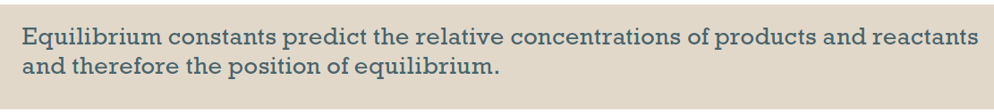
Size of the equilibrium constant
When calculating K remember that products are on top of the fraction.
If the K value is large:
the reaction goes towards completion
more products are present than reactants
equilibrium lies to the right.

Slide 33
Size of the equilibrium constant
If the K value is small:
the reaction only occurs to a small extent
more reactants are present than products
equilibrium lies to the left.
If the value of K is close to 1, then there are significant concentrations of both products and reactants present.

Slide 34
Yield and rate of reaction
Yield – how much product can be produced
Yield is dependent on position of equilibrium.
Reactions with low K values have low concentration of products and hence low yield.
The rate of reaction indicates how quickly this yield will be achieved.

Slide 35
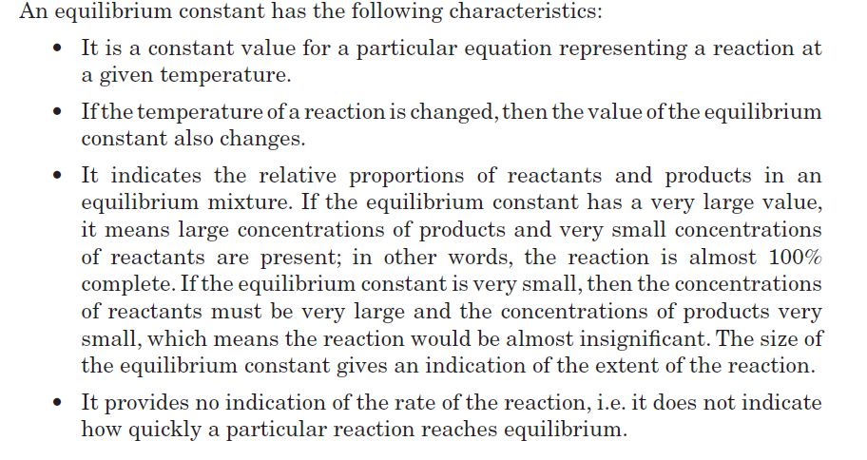
Summary

Slide 36
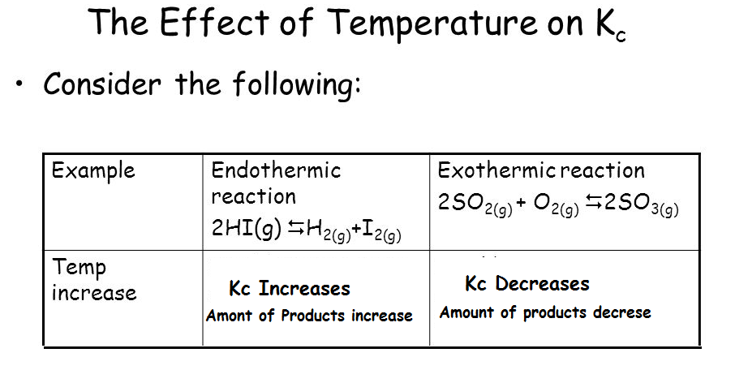
Temperature affects the K value…why?
Temperature affects the proportion of particles with enough energy to overcome the Ea.
It also depends on weather a reaction is exothermic or Endothermic.
As the temperature of a system increases-

Slide 37
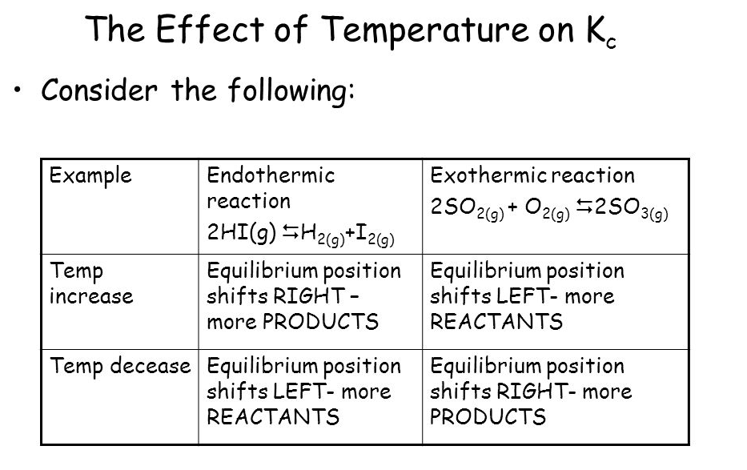

Slide 38
Chapter 2: Equilibrium
Effect of changes to temperature, pressure and concentration

Slide 39
Changes to equilibrium
If changes are made to:
temperature
concentration
partial pressure
of an equilibrium system then the ratio of products to reactants changes.
The system will favour either the forward or reverse reaction to return the system to equilibrium.
This often results in an overall increase in a particular species in the system.

Slide 40
Changes to concentration and partial pressure
When concentration of a reactant is increased (including pressure increases), collision theory states rate of reaction will increase due to increased collisions.
This uses additional reactant, reducing its concentration, reducing rate of forward reaction.
Additional product will form so rate of reverse reaction increases.
Eventually rates of the two reactions equalise.

Slide 41

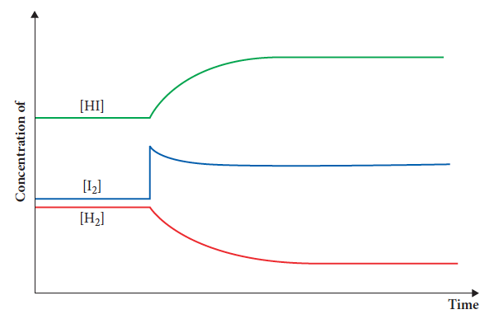
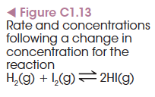
Changes to concentration and partial pressure
Using and Figure C1.13:
Iodine is added to the system, increasing the rate of the forward reaction.
Concentration of iodine and hydrogen reduce, while hydrogen iodide increases.
Notes:
Note the sharp increase of the iodine concentration – indicating that more iodine was added. A sharp change in one substance indicates an addition of a chemical rather than temperature/pressure change.

Slide 42
Changes to concentration and partial pressure
As more hydrogen iodide is produced, the rate of the reverse reaction increases.
This pattern continues until the forward and reverse rates are equal and equilibrium is re-established (parallel lines on graph).

Slide 43

Le Chatelier’s principle
To use the principle to predict changes in a system, consider:
1 What is the change?
2 What is the opposite of the change?
3 Which reaction is favoured – forward or reverse?
4 Does equilibrium shift left or right?
5 What happens to the concentrations of each substance?

Slide 44
Changes to concentration/partial pressure- Le Chatelier’s principle
If the concentration of a reactant is increased:
the system responds to decrease it by favouring the forward reaction, using up the reactant
equilibrium shifts to the right, increasing the concentration of the products and decreasing the concentration of reactants.
The system cannot fully counteract the change so the reactant concentration does not fully return to initial levels.

Slide 45
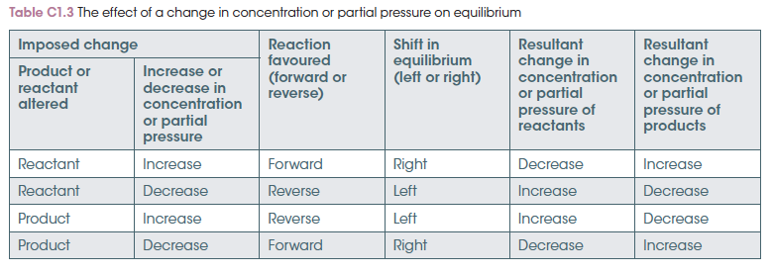
Changes to concentration/partial pressure- Le Chatelier’s principle
Changes to partial pressure result in concentration changes and the effect is the same.

Slide 46
Changes to volume and pressure
When volume or pressure of a system is changed, the concentration of all gaseous species is also changed.
The species that changes most has the greatest effect on equilibrium change.

Slide 47

Changes to volume and pressure
Consider
There is a ratio of 4:2 gas molecules between reactants and products.
If pressure is increased, all gases increase in concentration but there is a greater proportion of reactant gas molecules and more collisions.
Hence the forward reaction is favoured and more ammonia is produced.
Again, the rates eventually equalise and equilibrium is re-established.

Slide 48
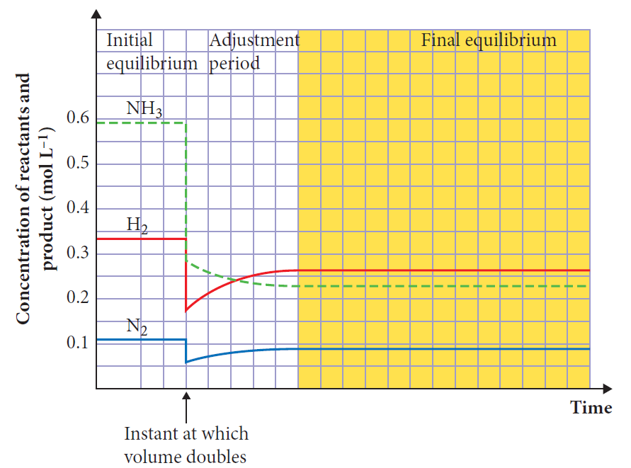

Changes to volume and pressure
The sharp change in all substances shows a change in pressure or volume rather than addition of one substance to the system.
Equilibrium re-established when concentrations remain constant.

Slide 49
Changes to volume-Le Chatelier’s principle
If the volume of a gaseous system changes, the concentration of all aqueous or gaseous substances changes.
Le Chatelier’s principle says the system will react to reverse this change and restore the initial concentrations.
The key to predicting what happens is the number of gas molecules in reactants and products.

Slide 50
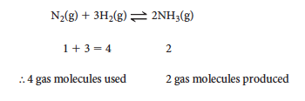
Changes to volume-Le Chatelier’s principle
Using an example:
If the volume of the system is decreased, then pressure of the system increases.
Le Chatelier’s principle says the system reacts to decrease the pressure by reducing the number of gas molecules.
The forward reaction is favoured and more ammonia is produced.

Slide 51
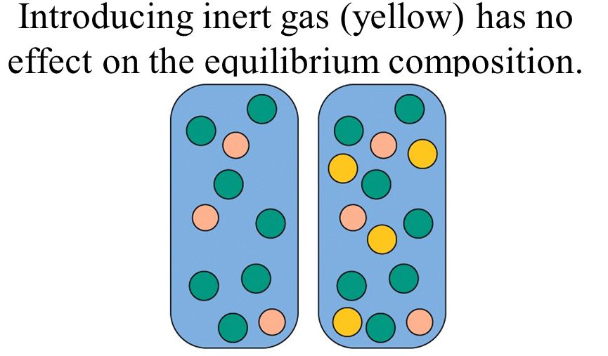
Adding an Inert gas
Equilibrium unaffected
Total pressure of the system increases without changing the concentrations of reactants and products.

Slide 52
Dilution
If we dilute a solution by adding solvent, all of the concentrations will decrease.
When we dilute a reaction at equilibrium the reaction will shift in such a way to increase the total concentration.
This means moving towards the side of the reaction with a greater number of species in solution.
Adding water does affect equilibrium for a reaction with different number of moles on each side.
Dilution of an aqueous ionic equilibrium favors the reaction that produces more ions.

Slide 53
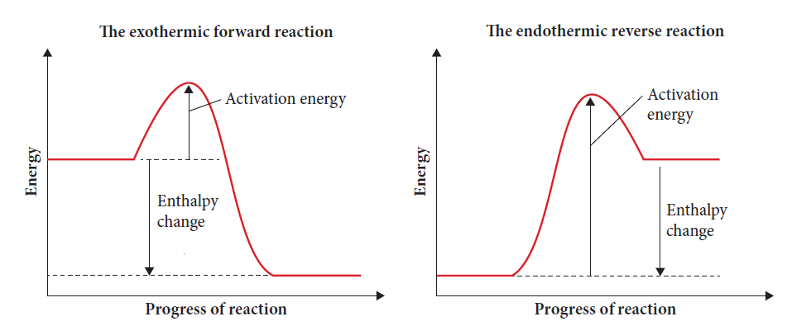

Changes to temperature
In an endothermic reaction, the products have more enthalpy than reactants, so energy is absorbed from the surroundings.
In an exothermic reaction, reactants have more energy so energy is lost to the surroundings.
Notes:
It is important to note here that the exothermic reaction has a lower activation energy than the endothermic reaction – as seen in the graph.

Slide 54

Changes to temperature
When temperature is increased, both forward and reverse reaction rates increase, but the endothermic rate will increase more.
A greater percentage of particles are able to react in the endothermic reaction due to the higher activation energy.
More endothermic products are produced, so the exothermic rate increases. Eventually equilibrium is re-established.

Slide 55
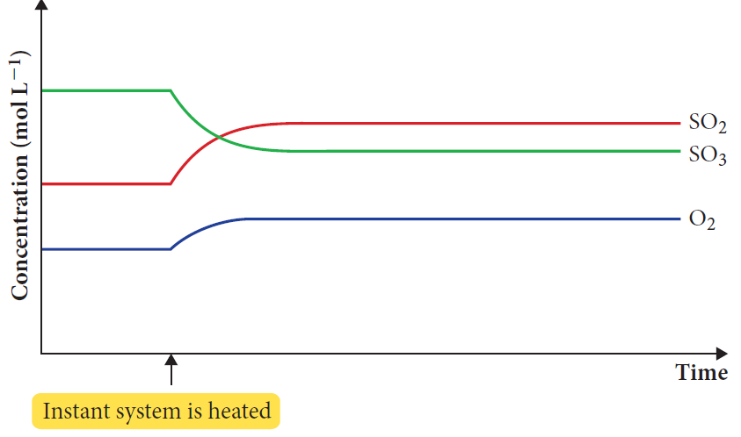
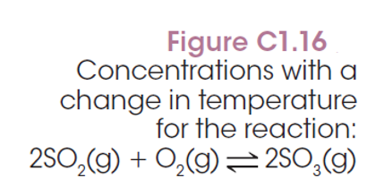
Changes to temperature
The forward reaction is exothermic.
If temperatures is increased, endothermic direction is favoured.
Reverse reaction favours increase in SO₂/O₂.

Slide 56
Changes to temperature - Le Chatelier’s principle
If temperature of a system is increased, then added energy is present.
Le Chatelier’s principle acts to oppose this change by driving reactions in an endothermic direction to absorb this energy.
If temperature is decreased, the exothermic direction is favoured to produce heat energy and oppose the change.

Slide 57

Changes to temperature - Le Chatelier’s principle
Consider production of ammonia:
The forward reaction is exothermic.
If temperature is increased, the endothermic reaction is favoured to use up the energy.
Reverse reaction is favoured and thus there is an increase in the production of nitrogen and hydrogen.

Slide 58
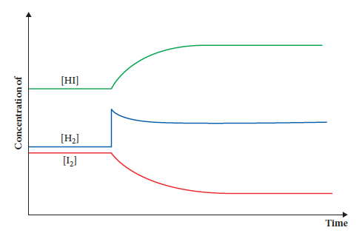
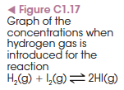
Graphing changes to concentration/partial pressure
Consider
In the graph, some hydrogen is added to the system.
Notes:
Use the graph to identify/explain the following:
The point where hydrogen was added (sharp increase in one substance only)
The period where equilibrium is being re-established (after addition while all substances undergoing change in concentration)
The point where equilibrium is re-established (no further change in concentration – parallel lines)
Also identify that there is more hydrogen iodide than initially present – hence this results in extra products being formed.

Slide 59

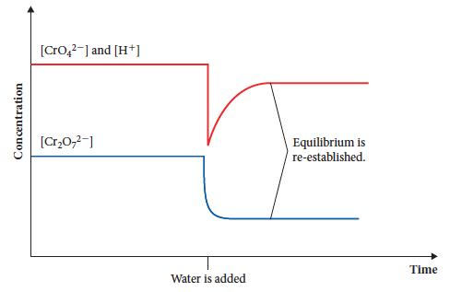

Graphing changes to volume or pressure
Consider the chromate/dichromate equilbrium:
Water is added to decrease the concentration of all aqueous substances.
Notes:
Use this example to explain/identify the following:
Point where water is added (decrease in concentration of all substances at the same time indicates volume/pressure change)
Identify where equilibrium is being re-established (where concentrations are changing)
Identify where equilibrium is re-established (where lines are parallel and no further change in concentration occurs)

Slide 60

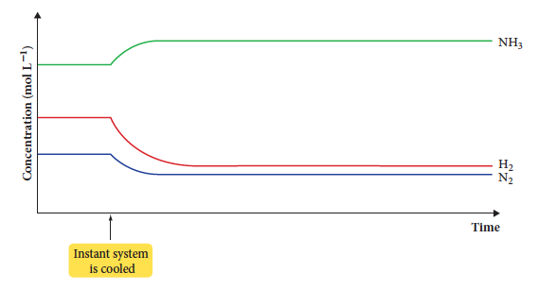
Graphing changes to temperature
Consider the formation of ammonia and a decrease in temperature of the system.
Notes:
Use the example above to identify:
where the system is cooled (change in temperature is indicated by a gradual change in all the substances and no sharp changes)
where equilibrium is being re-established
where equilibrium is re-established.

Slide 61
Presence of a Catalyst
A Catalyst lowers the activation energy and increases the reaction rate.
It will lower the forward and reverse reaction rates,
Therefore, a catalyst has NO EFFECT on a system at equilibrium!
It just gets you to equilibrium faster!

